Slide 1
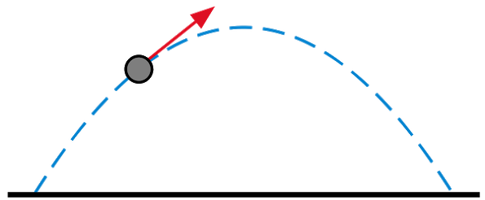
Game Maths & Physics
Subject Details

Slide 2


WHY?
https://www.digipen.edu/academics/game-design-and-development-degrees/bs-in-computer-science-and-game-design/sample-course-sequence

Slide 3
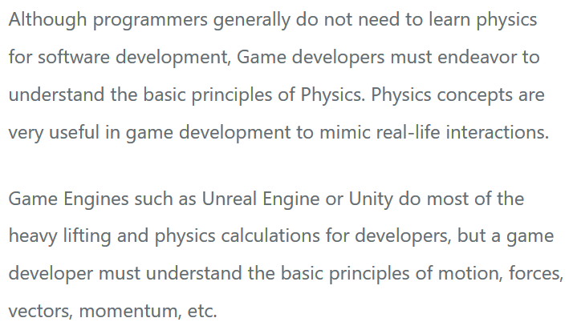
https://arkiana.com/do-programmers-need-to-know-physics/

Slide 4


Slide 5
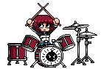
By the end of GMAPS you should be able to …
Understand the components and operation of a physics engine
Use a physics engine in your games
Use mathematics to ensure correct physics and mechanics in your games
Implement basic physics based mechanics without using a physics engine

Slide 6



Douglas Finnigan (Subject Leader)
douglas@tp.edu.sg 67805304
douglas@tp.edu.sg
Nur Aisha Khalid (Tutor & Diploma Manager)
nur_aisha_khalid@tp.edu.sg 67806928

Slide 7
1
Intro to GMAPS
Vectors PART 2
Vectors PART 1
GMAPS_Vectors_Worksheet.docx (Q3-Q4)
GMAPS_Vectors_Worksheet.docx (Q1-Q2)
2
Vectors PART 3
Vectors PART 4
GMAPS_Vectors_Worksheet.docx (Q6-Q7)
Vectors (complete the worksheet)
Self-revision using ChatGPT prompt
3
Matrices PART 1
Matrices PART 2
Project requirements released
GMAPS_Matrices_Worksheet.docx (Pt 1)
GMAPS_Matrices_Worksheet.docx (Pt 2)
4
FLEX Week
5
Dynamics & Kinematics PART 1
Dynamics & Kinematics PART 2
GMAPS_Kinematics_Worksheet.docx (Pt 1)
GMAPS_Kinematics_Worksheet.docx (Pt 2)
6
Simple Collisions – Part 1
Test Revision
GMAPS_Collisions_Worksheet.docx (Pt 1 & 2)
Test (1 hour)
In–class Test (1 hour)
30%
Testing of Weeks 1-3
7
Simple Collisions – Part 2
Simple Collisions – Part 3
(including worksheets)
GMAPS_Collisions_Worksheet.docx (Pt 3)
GMAPS_Collisions_Worksheet.docx (Pt 4)
Work done in class. Which worksheets to submit will be stated during class.
8
Project consultation (Online)
Project consultation
Worksheets submission
30%
9
Group, but individual assessment. Submit a gp. video presentation + ind. implementation.
10
Project submission
40%

Slide 8
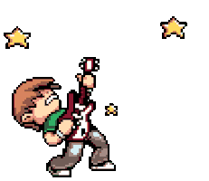
You are now in TERM MODE!
16 weeks → 8 weeks (-1 Flex Week)
You don’t have so many subjects all at the same time.
Relatively tight schedules.
Frees up time for extended Major Project / Internship.
You have to keep up – no slacking!
If you fail, you can repeat without taking an extra semester.
Less time to learn – but also more focused

Slide 9
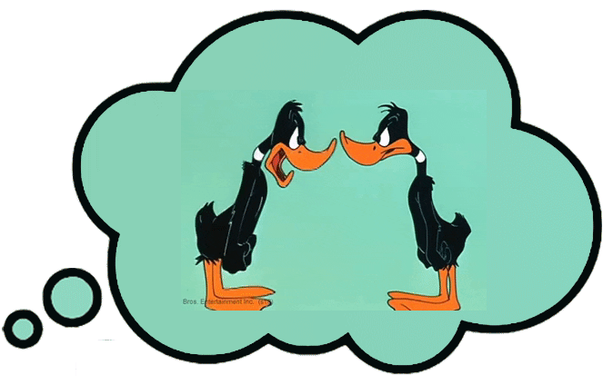
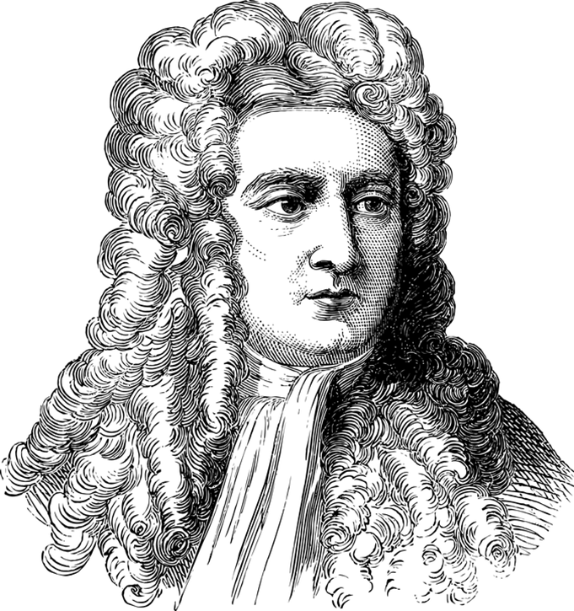
Game Maths & Physics
So, what is
For every action, there is an equal and opposite reaction.

Slide 10
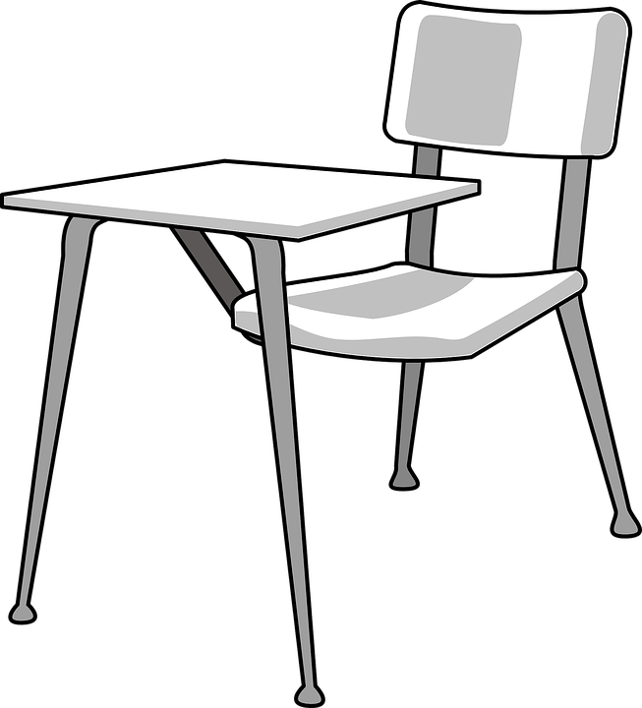
Could you throw a coin on your desk
then throw another coin onto it?
Notes:
https://bank-24h.com

Slide 11

What about placing a coin on your desk
then placing another coin onto it?
Notes:
https://bank-24h.com

Slide 12

An object can be moved …
by controlling its position directly, according to math
by applying various forces that act on the object
Of course you can argue that in real life, all objects are directly or indirectly moved by forces --your arm moves by the muscles applying forces to the joints.
What is a force that acts on all objects all the time?!
gravity
Notes:
https://bank-24h.com

Slide 13
The are two ways to study movement
We’ll look at both in GMAPS
Kinematics
Dynamics
Kinematics is the study of only the motion of objects without taking into consideration the causes of that motion.
Dynamics is the study of motion of the objects along with their cause (forces and torques).
It doesn't ask "how did the velocity of the body change?" Only, "by how much did it change?"
It asks why did the velocity change.
Motion is treated geometrically, without reference to the forces of motion.
Motion is treated in terms of trajectories and time. This is where forces and equations of motion come in.
https://www.quora.com/What-is-the-difference-between-Kinematics-Kinetics-and-Dynamics

Slide 14

Why did we do all that?
To think about how things move
https://giphy.com/gifs/3o6gE6MAgbds5fxJao

Slide 15

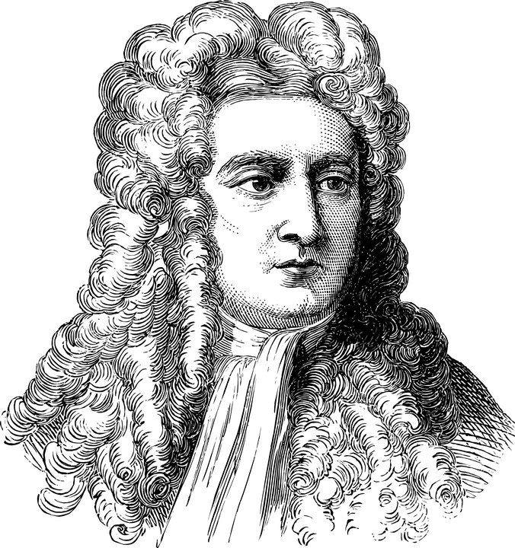

The science concerned with the motion of objects under the action of forces is called
DYNAMICS
Isaac Newton

Slide 16

https://dribbble.com/shots/2191423-Vintage

Slide 17
Making objects appear to move realistically is a core part of many games.
To do this, we must simulate the action of forces on objects in the game.
The dynamics simulator in a game is usually called a PHYSICS ENGINE.
So, the first part GMAPS is about how to use a game physics engine to simulate movement.
We’ll then move on to learn how to program your own physics.

Slide 18
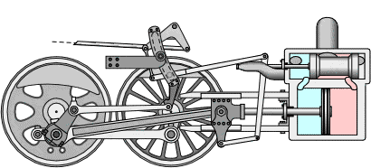
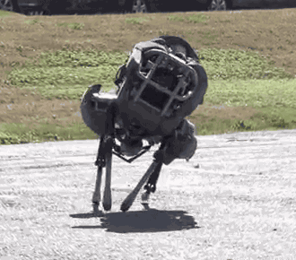
Is this a real animal?
No, it is a simulation of an animal

Slide 19
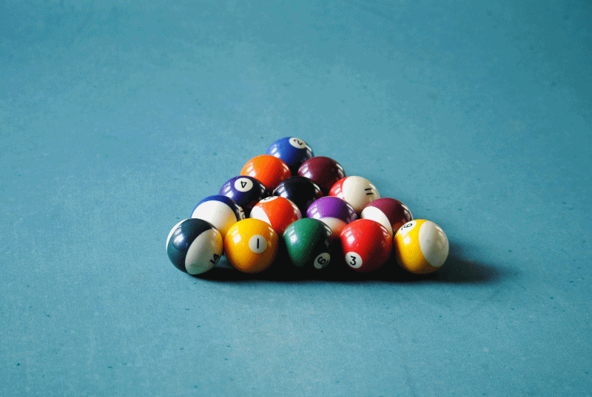
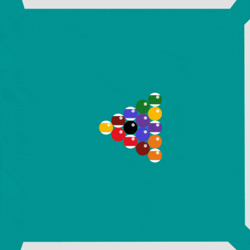
Real physics
Simulated physics

Slide 20
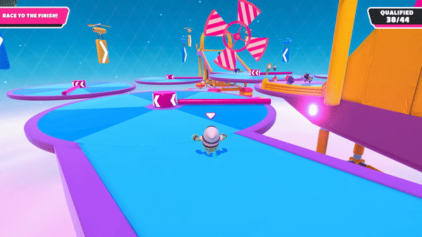
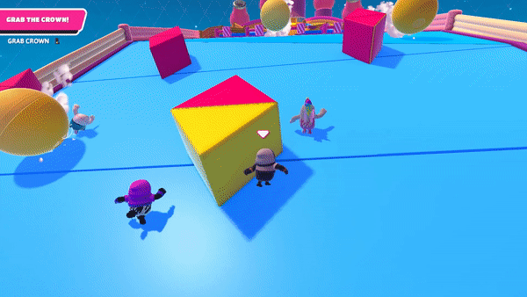
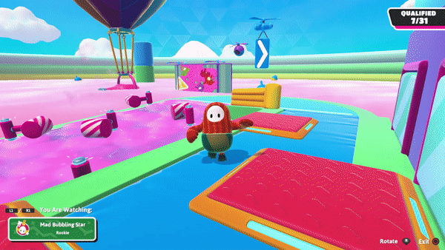
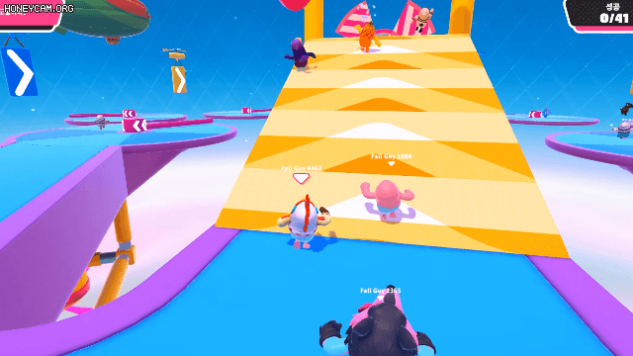
A good example of a physics-based game
You can play this Fall Guys clone online (though the real game is now free):
https://fall-guys.co/

Slide 21
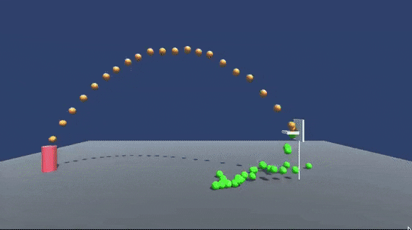
The red “player” throws a ball at the hoop.
To simulate the throwing, what do we need to know?
How could this be shown graphically?
The direction to throw the ball in.
How much force to throw the ball with.
https://medium.com/tensorflow/tf-jam-shooting-hoops-with-machine-learning-7a96e1236c32

Slide 22
Magnitude
Direction

Slide 23
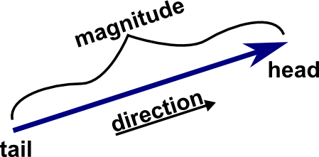
y
(3, 1)
1
x
3
For simplicity, we’ll focus on 2D for now
VECTOR

Slide 24
Vectors are the physical quantities with both direction and magnitude.
Force, as we know, has both direction and magnitude.
So we can represent force as a vector.
Force
y
https://www.chegg.com/homework-help/definitions/force-as-a-vector-2
This does NOT mean that every vector represents a force – just that force can be represented by a vector.
x
Force has an x component and a y component.
We’re looking at 2D here. 3D would also have a z component.
Notes:
For example, age can be represented by a number, but this doesn’t mean that every number is an age.
A number can represent age, height, speed, mass, salary etc.
A number can represent any scalar quantity. Scalars are quantities that are fully described by a magnitude (or numerical value) alone.
Likewise, a vector can represent any quantity that has direction and magnitude.
See this video: https://www.youtube.com/watch?v=Yfc6rAFOI4I

Slide 25
To simulate the throw, we need to know something else.
How the position of the ball changes over time.
y
x

Slide 26


How should we represent position?
+y
Where am I?
-x
+x
(x, y)
-y
?
Where is the 0 position between –X and +X ?
Where is the 0 position between –Y and +Y ?
Some of this might seem obvious, but it’s important to have a deeper understanding of things we usually take for granted!
What units do we measure X and Y in ?
What units do we measure X and Y in ?
Are these units domain dependent, e.g. in space vs on Earth ?
Notes:
Questions to ask:
Where is the 0 position between –X and +X ?
Where is the 0 position between –Y and +Y ?
What units do we measure X and Y in?
What is the “step size” between unit values e.g. what is (Xn+1) – Xn ?
Are these units domain dependent?

Slide 27
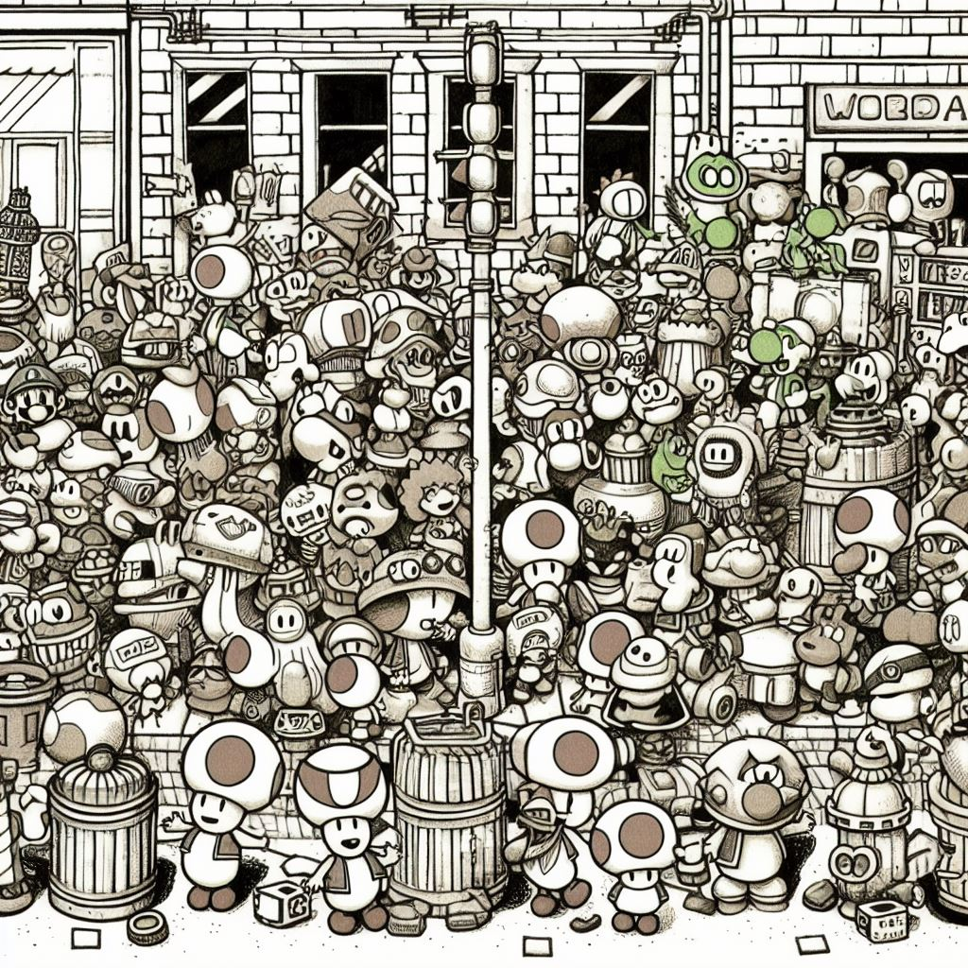
Where’s Mario?
Over here!

Slide 28
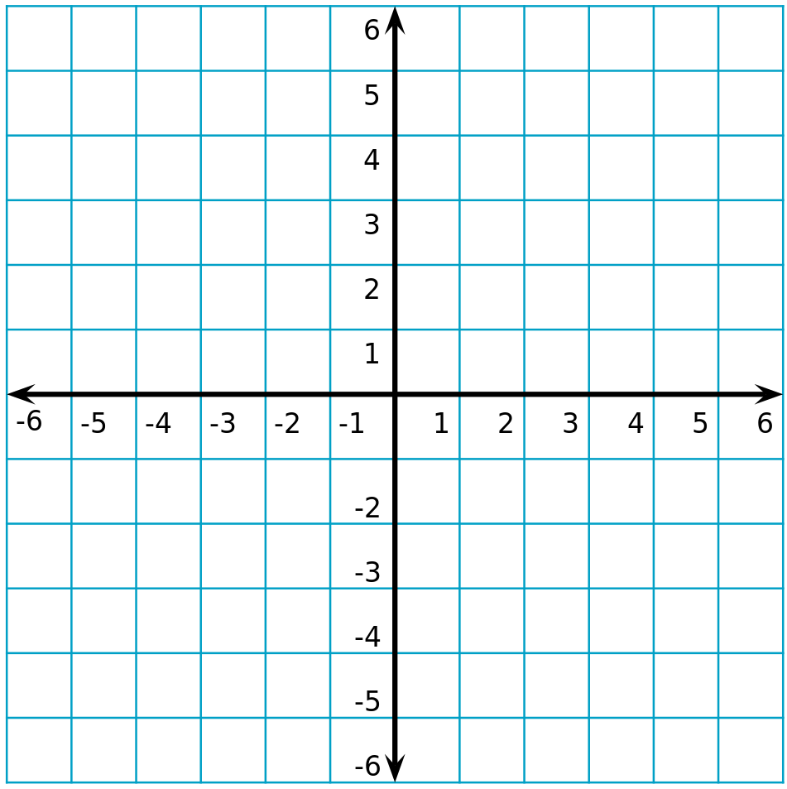
But Mario takes up a lot of space! How to set a single position?
The (0,0) point can go anywhere, so we’ll put it at the center of the screen.
We’ll use the center point for now.

Slide 29
Which puts Mario at (5, 2)

Slide 30
What does this remind you of?
(5, 2)
A vector!
Position can be represented as a vector, where the tail is always at (0 0)
What does the magnitude of the vector represent now?

Slide 31
(-4, 5)
B
(5, 2)
A
What if we want to calculate some property of vectors, eg the angle between vector A and vector B?

Slide 32
(?, ?)
Or rotate a vector?
(5, 2)
0

Slide 33
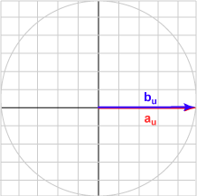
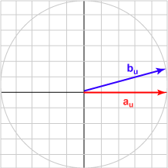
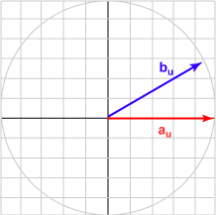
MATRIX
b_{x}
b_{y}
b_{z}
a_{x} a_{y} a_{z}
=
a_{x}b_{x} + a_{y}b_{y} + a_{z}b_{z}
MATRIX
A ∙ B
Called the DOT product
Vector A = (1.0, 0.0)
Vector A = (1.0, 0.0)
Vector A = (1.0, 0.0)
Vector B = (1.0, 0.0)
Vector B = (0.966, 0.259)
Vector B = (0.866, 0.5)
Dot product = 1.0
Dot product = 0.966
Dot product = 0.866
Angle = 0 degrees
Angle = 15 degrees
Angle = 30 degrees
https://chortle.ccsu.edu/VectorLessons/vch09/vch09_6.html

Slide 34
PLAGIARISM
If you plagiarise or copy any assessment, including the worksheets, you will FAIL the whole GMAPS subject.
Both the copier and the person who gives their work to be copied will be penalized.
IMPORTANT: “Discussing” the assessments with your friends usually leads to plagiarism penalties. DO NOT show or discuss your assessed work with anyone.

Slide 35
ChatGPT
And any other generative AI (Gen AI) tools
You may use Gen AI to help understand the topics, to brainstorm, to check and debug your interim code.
You may NOT use Gen AI to write final code, code comments, reports, or any other work.
Any submitted work that is deemed not to have mostly human input will be considered plagiarised.

Slide 36
GitHub
Your GMAPS Worksheets project, and your final project, must be done using GitHub.
You must commit all changes as you modify your code and other assets.
If any work is submitted without a GitHub link, you will obtain at most a D grade for that assessment.

Slide 37

That’s just a brief introduction to the MATHS part of GMAPS!
We’ll look at vectors and matrices in more detail later.
First, we’ll review Unity’s physics engine …

Slide 38
